Slide 1

M V S ◆ Weekly Review
Weekly Progress & IT Assets
2026 Week 45, 05/11/2026
MVS ICT & Telecom
Weekly Presentation
Presenter: Danish Akbar
Position: IT Support

Slide 2
M V S ◆ WEEKLY OPERATIONS
Weekly Progress & Next Steps (Week 45)
◆ MVS ICT & Telecom Web Portal
✓ LIVE & DEPLOYED
◆ Salam CCS — KPI Framework
● IN PROGRESS (30%)
• Live at portal.mvsksa.com: Successfully deployed on Hostinger cloud infrastructure with active SSL encryption.
• Role-Scoped Dashboards: Dedicated workspaces for Executive Command Center, Project PMs, and Commercial Sales.
• Excel-Exact Reporting: Real-time PO realization, milestone invoicing lifecycle, and cash collection tracking.
• Automated GitHub CI/CD: Connected repository for seamless real-time production deployment.
• Operational Data Received: Received operational records & patrolling data from Mr. Tahir Anjum; analysis and validation are currently in progress.
• Scoring & KPI Logic: Structuring calculation models for SLA compliance, CMR/PMR resolution, patrolling (TPC/POI), and team rankings.
• Executive Scorecard View: Designing unified KPI dashboard layout for weekly management review upon completing calculations.
◆ FO Route Survey Application (DCP-1)
◆ UPDATES & RESERVED
◆ IT Infrastructure & Asset Governance
✓ ON TRACK
• Reserved for Next 7 Days: I will be reserved for the next 7 days dedicated for DCP operational tasks, alignment, and technical delivery.
• Ongoing QA & Stationing: Continuous survey alignment checks, ROW utility classification, and highway mapping across active sections.
• Production & Field Support: Supporting technical survey teams with real-time KMZ exports, coordinate mapping, and database backups.
• Centralized Cloud Shared Folders: Structured OneDrive departmental folders with role-based access; pending final approval from Engr. Mounir.
• Asset & Telecom Custody Audit: Active tracking maintained across 77 hardware units (73 in use, 4 in office stock) and 50 active telecom SIM lines.
• Daily Corporate IT Support: Continuous meeting room AV maintenance, workstation troubleshooting, and user security assistance.
Modern Vision Solutions 2026 • MVS ICT & Telecom Slide 2 of 3

Slide 3
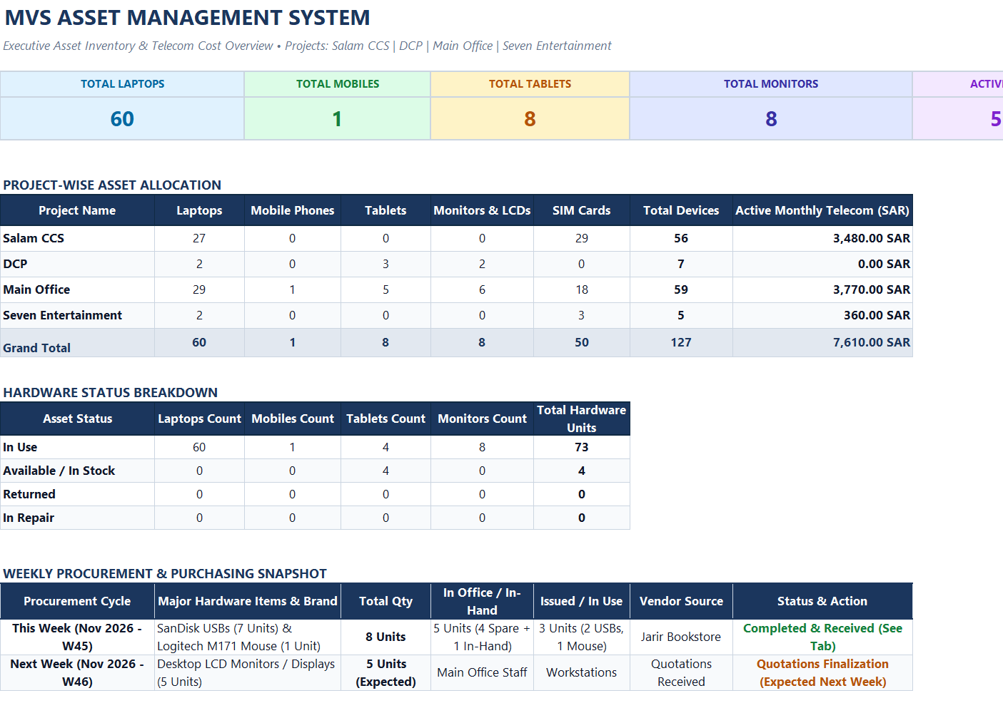
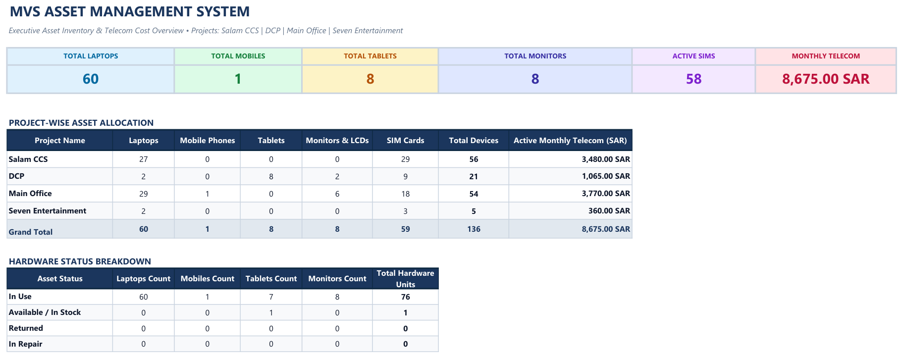
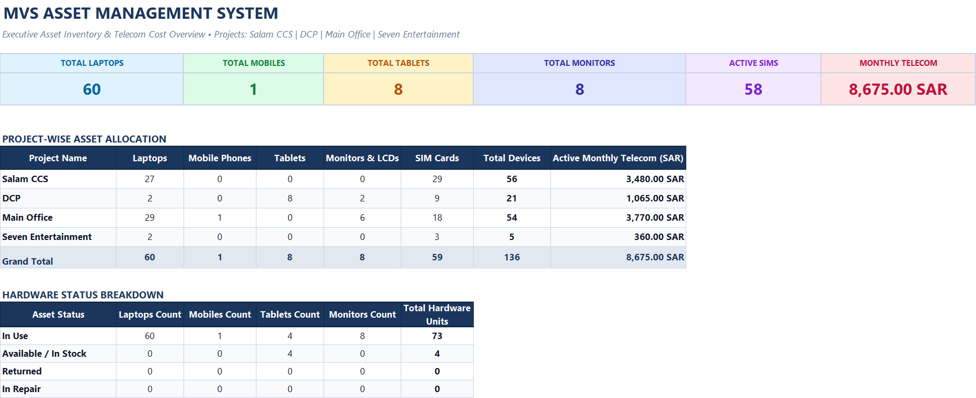
M V S ◆ ASSET MANAGEMENT
IT Assets & Telecom Inventory Dashboard
Modern Vision Solutions 2026 • MVS ICT & Telecom Slide 3 of 3

